Slide 1
Solar-Power Conversion Kit
Sponsored by: LaniEV
Spring 2026
Team 6
Alec Snodgrass, Parker Branson, Landon Paul, George Vaporis, Nathan Galloway

Slide 2
Outline
Background and Stakeholders
Problem Formulation and Existing Solutions
Standards and Regulations
Broader Impacts
Conceptual Design Overview
Subsystem Detailed Designs
Summary

Slide 3
Background
Engineering Context
Project Formulation
Root problem
Carbon emissions from combustion engines
Existing solutions
Existing electric-power vehicles
Issues with this solution
Power companies must supply extra power
Extra power means greater stress
This solution is not long term
Golf carts are a major form of transportation
Lead-acid batteries are used to power the carts
Issue
These types of batteries have major drawbacks
Lead-acid batteries are nonrenewable
Questions and Concerns
Is there a better solution?
Can a renewable resource be used instead?
Can this solution be used universally?

Slide 4
Stakeholders
Parties Involved
Context
LaniEV
Primary customer
Sponsoring company
Providing major materials to the team
Primary source for information and assistance
TN Technological University
Secondary beneficiary
Accredited institution
Providing a team of capstone students
Responsible for validation
Golf car consumers
Extended
Secondary customer
Main focus regarding design and manual
Legacy lead-acid battery systems in LSVs/golf cars:
Low energy density, short lifecycle, high maintenance
Environmental and cost inefficiencies
Lack of a validated retrofit framework limits large-scale adoption
Engineering Need:
Develop a universal solar + LiFePO₄ retrofit system
Provide validated performance, safety, and economic data for commercialization

Slide 5
Problem Formulation
Problem Statement
Key Specifications
Legacy low-speed vehicles and golf cars rely on lead-acid battery systems that impose limitations on energy density, life cycle, maintenance burden, and environmental impact, reducing overall efficiency and sustainability. The absence of standardized, validated performance and safety data for alternative energy systems prevents large-scale adoption and commercialization.
Documentation & Validation
Initial vehicle condition report (baseline characterization)
Step-by-step conversion manual + installation logs
Post-conversion wiring schematic
Design & Build
Survey top OEM platforms (Club Car, E-Z-GO, Yamaha)
Universal mounting kit CAD (≥2 platforms compatible)
Functional prototype fabrication
Analysis
Performance testing (efficiency, charge/discharge behavior)
Environmental impact (lead reduction, kWh savings)
ROI and economic scalability models

Slide 6
Standards and Regulations
Constraints
Measures of Success
Electrical & Safety Standards
NEC (NFPA 70), NFPA 70E, NFPA 855
OSHA 29 CFR 1910 (LOTO, electrical safety)
Design & Certification
UL standards (battery, BMS, converters)
SAE J2344 / J1772 (EV safety & charging)
IEEE 1547 (grounding, interconnection)
Regulatory
FMVSS (LSV compliance)
EPA (battery disposal & environmental handling)
ANSI Z535 (safety labeling)
Technical Performance
Improved energy efficiency vs. lead-acid baseline
Stable solar-assisted charging behavior
Reliable power delivery under load
Design Validation
Universal kit fits ≥2 major LSV platforms
Non-invasive, structurally stable installation
Documentation Quality
Reproducible installation + conversion procedures
Complete electrical and mechanical validation
Impact Metrics
(Stretch Goal) Quantified reduction in lead waste & grid usage
Scalable model for fleet-level adoption

Slide 7
Broader Impacts
Global and Cultural Impacts
Economic and Environmental Impacts
Increased Commercialization
Increased electrical integration in smaller vehicles
Expanded Areas of Use
Off-grid use
Rural communities
Reduced Dependence on Electrical Grid
Charging stations
Affordability
Large fleets
Cheaper than alternatives
Increased Jobs
Manufacturing
Kit installation
Kit maintenance
CO2 Emissions
Locally Reduced

Slide 8
Broader Impacts
Ethical Considerations
Public Health, Safety, & Welfare
Honesty in Performance
Limitations
Affordable
Select cheap options without compromising safety
Standards
All regulatory standards must be met
Physical Safety
Design is safe
Customers
Maintenance workers
Electrical Safety
Connections are safe
Fuses
Protected from elements

Slide 9
Existing Solutions
Cart Solutions
Solar Panel Solutions
Battery Solutions
Monocrystalline
Chosen
Polycrystalline
Thin-film
Less efficient
Shorter lifespan
Gas
Electric
Renewable
Solar panel
Monocrystalline
Polycrystalline
Thin-film
Lithium-ion
Chosen
Flood acid
Absorbed glass mat
Nickel-based
Weight
Range
Space
Cost

Slide 10
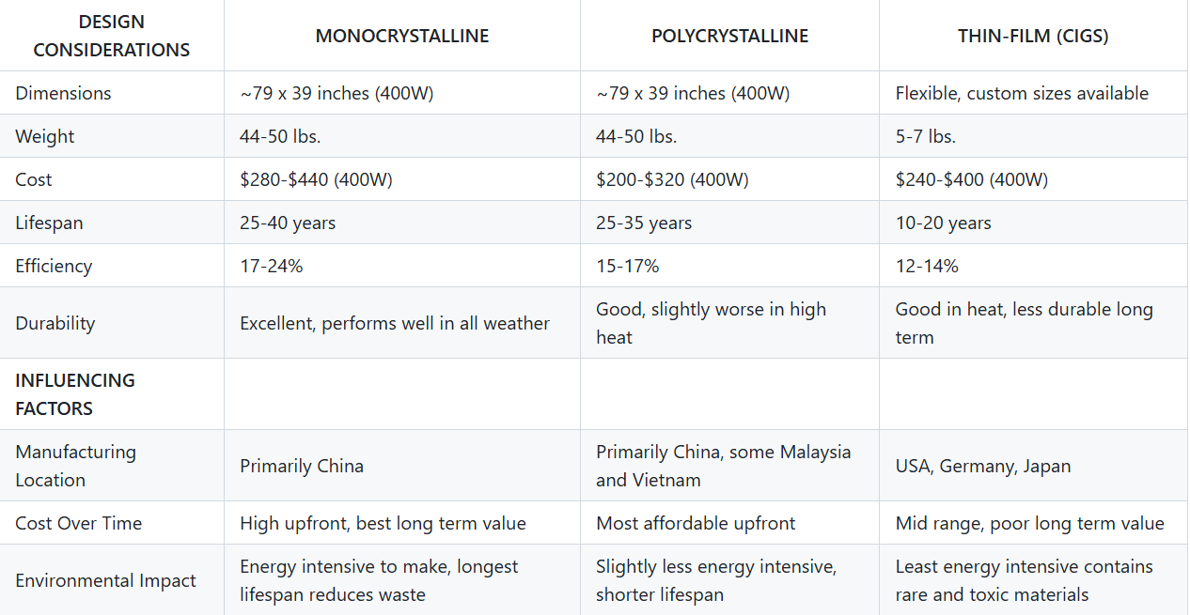
Solar Panel Comparison

Slide 11
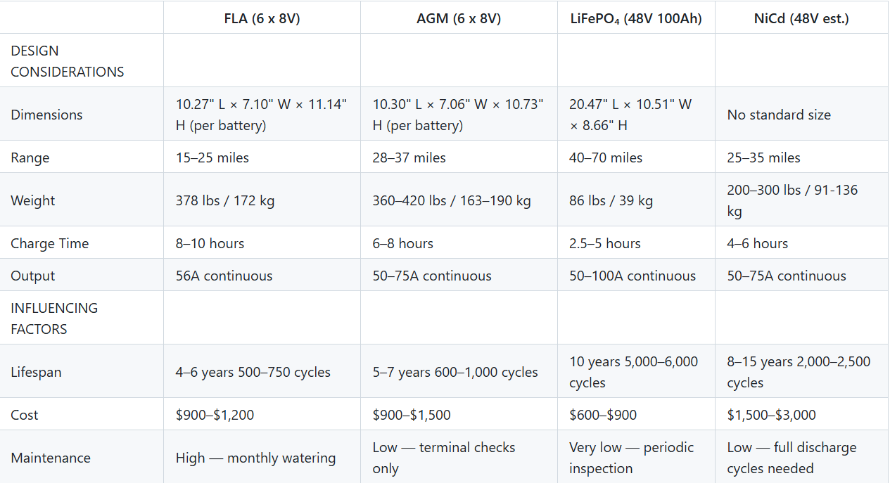
Battery Comparison

Slide 12
Block Diagram
Initial Condition
Breakdown
Assembly
Documentation
Wiring
Completed Retrofit
Universal Retrofit

Slide 13
Solution Operation
Document Initial Condition
Vehicle Preparation
Existing Kit Assembly
Existing Kit Documentation
Existing Kit Analysis
Existing Kit Wiring and Power
Universal Kit Design
Universal Kit Manufacturing
Universal Kit Assembly
Universal Kit Documentation
Universal Kit Testing & Analysis
Universal Kit Wiring and Power

Slide 14
Detailed Design Subsystems
Vehicle Preparation
Prepare the existing golf car for retrofit
Battery System Installation
Install the battery, make necessary wire connections, and take any necessary safety precautions
Structural Frame Design
Design a mounting system for the solar panel that is compatible with the three primary golf car manufacturers
Power Management and Charging
Ensure the battery and solar panel are connected properly, and the wiring of the power system complies with regulations
Solar Energy System
Mount the solar panel and connect the wiring.

Slide 15
Vehicle Preparation: Pre-conversion
Specifications and Constraints
Proposed Solution
Interface with other Subsystems

Slide 16
Vehicle Preparation: Specifications & Constraints
OSHA Electrical Safety
29 CFR 1919.147
NFPA 70E
EPA & State Environmental Regulations
Lead-acid battery removal
Physics / Structural Constraints
Parts Removed
Battery compartment inspected
Socio-Economic Constraints
Removed components removed labeled

Slide 17
Vehicle Preparation: Overview
Vehicle Condition
Pre-modification
Lockout / Tagout
De-energize
Clear Obstructions
Removal of components

Slide 18
Vehicle Preparation: Interface with Other Subsystems
Electrical Subsystem
Battery / Power Subsystem
Mounting locations
Controller mounting Surface
Wire management
Cleared battery compartment
Level mounting surface
Battery housing / enclosure
Assessable compartment for wiring and maintenance

Slide 19
Battery Installation
Function
Constraints
Main source of power
Six 8V batteries --> One 51.2V battery
Dual charging
Solar panel
Wall outlet
Mounting
Configuration to housing compartment
Electrical
Correct battery is chosen
Circuit
Replace old or improper wiring
Environmental
Water damage to wiring and battery
Lightning strikes
Specifications
Documentation of installation process

Slide 20
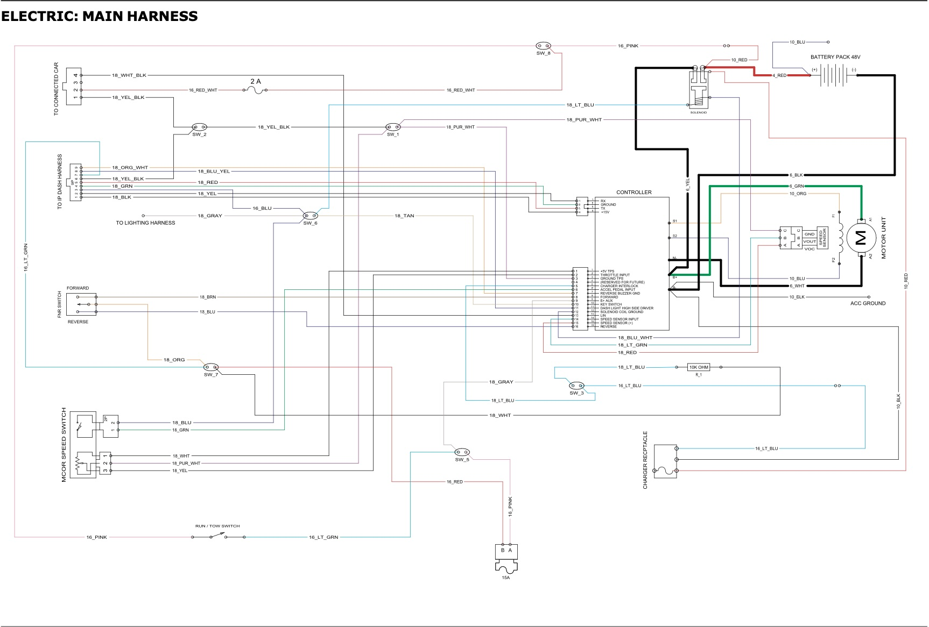
Battery Installation
Overview
LiFePO4
Light Weight
Constant voltage
Battery Management System (BMS)
Waterproof insulation
Create a mold for any golf cart
Summer Tasks
Install LiFePO4 Battery
Fit and install Waterproof insulation
Replace worn out wiring or electrical components
Diagram of main harness
Location of battery
Depicts main connections

Slide 21
Structural Frame Design
Functions
Compatibility
Supports and secures rigid roof-mounted solar panel
Interfaces with OEM golf cart chassis
Provides structural mounting points:
Solar panel
Electrical routing components
Optional charge controller enclosure
Protects and routes electrical wiring
Maintains structural integrity under:
Static loading (self-weight + solar panel)
Dynamic loading (vehicle motion, vibration, wind)
Adjustable mounting architecture
Must be universal
Club Car
E-Z-GO
Yamaha

Slide 22
Structural Frame Design - Constraints
Mechanical
Static + dynamic loads
Deflection parameters
Safety factors
Geometric Constraints
Designed for specific makes and models
Should not hinder usability
Electrical Integration
Wire routing
Electrical protection
Environmental Durability
Rain, heat, cold, UV, humidity
Corrosion resistance
Manufacturing
Welded prototype
Bolt-on final design
Aluminum extrusion
CNC-machined brackets
Governing Agencies
OSHA, SAE, ANSI, NEC…

Slide 23
Structural Frame Design - Overview
Design
Vertical supports (4x)
Horizontal cross-members (4x)
Top mount plate / Rail system
Universal mount
Adjustable base brackets
Telescoping cross-members
Modular roof interface plate
Electrical integration
Hollow frame channels
Grommet-protected ports
Underside enclosures

Slide 24
Power Management Subsystem
Functions
Compatibility
Safely Transfer Power
Solar Panel --> Battery
Existing Electrical Architecture
Lights, turn signals, horn
Remain fully functional
Provide Protection
Power Surges
Weather Resistant
Installation Easily Replicated
Universal
E-Z-GO
Yamaha
Club Car

Slide 25
Power Management Subsystem
Constraints
Overview of Solutions
Existing Architecture
Existing golf car
Limited space in electrical housing
New battery
Charging unit
Battery Change
Six 8V batteries --> One 51.2V battery
Fewer connection points
Power Generation
Varying conditions
Limited space for panel
Plastic Housing
Shaped to fit
Increased structural stability
Fuses Implemented Throughout
Overcurrent
MPPT Controller
Increase efficiency

Slide 26
Solar Energy Subsystem
Function
Supply energy
Solar to electrical energy
Supply covering
Acts in place of a roof
Constraints
Panel frame
Does not fit frame
Panel wiring
No direct path

Slide 27
Solar Energy Subsystem
Interface with OtherSubsystems
Panel to structure frame
Panel wiring to battery
Summer Tasks
3D Model of Custom Mechanical Components
Buildable Schematic
Flowchart

Slide 28
Statement of Contributions
Alec Snodgrass
Stakeholders
Problem Formulation
Solution Operation
George Vaporis
Broader Impacts
Power Management Subsystem
Landon Paul
Background
Battery Installation
Nathan Galloway
Existing Solutions
Solar energy Subsystem
Parker Branson
Standards and Regulations
Pre-conversion Golf Car Preparation

